Slide 1
Ethical Hacking Training
-

Slide 2
Agenda
Hacking Short Intro
Impacts of hacking
Skills required
Types of Hacker
Phases of Hacking
Skills required
Notes:
l

Slide 3
Hacking short Intro
Ethical hacking refers to the act of locating weaknesses and vulnerabilities of computer and information systems by duplicating the intent and actions of malicious hackers.
Ethical hacking is also known as penetration testing, intrusion testing, or red teaming
The use of learning ethical hacking you will gain System knowledge and you can apply that to Good purpose.
Note: Stay Legal & use your skills for Good Purpose.

Slide 4

Impacts of hacking

Slide 5
Skills Required

Slide 6
Types of Hacker’s
White Hat
Black Hat
Grey Hat
Script kiddies
State sponsored
Cyber Terrorists
Suicide hacker
And more…

Slide 7
Phases of Hacking
Reconnaissance [ foot printing ]
Scanning [ enumeration also covered]
Gaining the access
Maintaining the access
Clearing the tracks

Slide 8
RECONNAISANNCE

Slide 9
Reconnaissance:
“Give me six hours to chop down a tree and I will spend the first four sharpening the axe”
Abraham Lincoln
Process of collecting or gathering an information about target as much as possible
Why it’s important:
Reduce the scope
Find out the attack vector

Slide 10
Types of Recon [Reconnaissance]
Active
interacting with target, to collecting the information
Ex: port scanning, ping
Passive
Without interaction, to collecting the information about target.
Ex: job site, search engine, social networks

Slide 11
IP Address & DNS information
Find out the target IP address and DNS information
Open source tool:
dnsenum [ preinstalled in kali ]
Tool:
whois
Ping utility
Whois

Slide 12
Google Dorks
Available: https://www.exploit-db.com/google-hacking-database
search string that uses advanced search operators to find information
Sample query:
Intext:”index of /”
Inurl:admin
Site:google.com
Ext:*.pdf

Slide 13

Way back Machine
digital archive of the World Wide Web and other information on the Internet.
Tips:
Analyse source code, you might seen what kind of feature they upgraded.
Available:
https://web.archive.org/
https://archive.org/web/

Slide 14
Net craft
Find out the OS details and more..
Available:
https://searchdns.netcraft.com/

Slide 15
Subdomain finder
Gathering the subdomain list of target domain
Mostly vulnerability present in subdomain [ less travelled path ]
Open source tool:
https://github.com/aboul3la/Sublist3r

Slide 16
Shodan.io
Search engine for security
Exist the vulnerability details about target.
Link:
https://www.shodan.io/
Similar website :
censys.io
https://censys.io

Slide 17
Misc
Pipl.com
Pipl is the place to find the person behind the email address, social username or phone number
Temporary mail
provides temporary, anonymous, free, secure, disposable email address. You can use on Facebook, twitter or Instagram for anonymously
Note:
A lot of open source tool’s available in internet.

Slide 18
SCANNING

Slide 19
Scanning
Set of procedure for identifying hosts, ports and services in a network.

Slide 20
Pre requisite
Below pre requisite knowledge are mandatory to performing scanning.
TCP/IP communication
TCP/IP Flags details
Packet working flow
NMAP
Ping utility and custom packet crafter tools

Slide 21
TCP/IP Communication

Slide 22
TCP/IP Flags

Slide 23
Custom packets by using flags
Scanning the network by using custom packet method.
Except some loophole & information
Tools:
Nping
CatKARAT Packet Builder
Available:
CatKARAT
packetbuilder.net
Nping
https://linux.die.net/man/1/nping

Slide 24
Network Mapper [ NMAP ]
Available:
https://www.stationx.net/nmap-cheat-sheet/
https://hackertarget.com/nmap-cheatsheet-a-quick-reference-guide/
https://blogs.sans.org/pen-testing/files/2013/10/NmapCheatSheetv1.1.pdf

Slide 25
Scanning Methodology
Look for live ports
Look for open ports
Scanning Techniques
Evade IDS
Banner Grabbing
Vulnerability scanning
Build Network diagrams
Use proxies
Scanning reports

Slide 26
Live ports
Checking the host is alive or not by using ICMP request/response method
Method to check
PING: Packet InterNet Groper.
Set of Internet control management protocol [ ICMP ] packet send to destination address, you will get ICMP response from destination address if it’s alive and able to processing the ICMP request packet else you wont get it.
How is it works ?
https://www.youtube.com/watch?v=XOSs9X98lkU

Slide 27
PING SWEEP
Determine the live hosts available in a network.
Tools:
Nmap
Ping utility

Slide 28
How it’s works

Slide 29
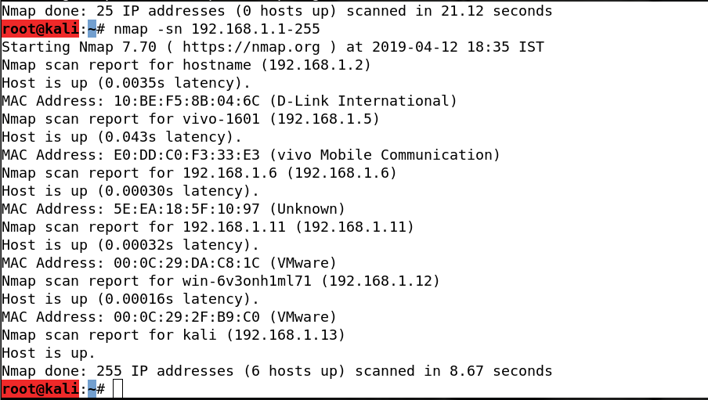

Slide 30
Open ports
Open ports means,
A TCP or UDP port number that is configured to accept packets.
In contrast, a port which rejects a connection or ignore all packets directed to it is closed ports.
Okay, then why ?
Attempt to exploit potential vulnerabilities any services .

Slide 31
Scanning Techniques

Slide 32
TCP Connect / Full open scan [-sT ]
Completing the three way handshake [ full connection ] and tear it down by sending RST packet.
Nmap command:
nmap –sT < target >

Slide 33
Stealth Scan [ -sS ]
RST [packet ] the connection before complete the three way TCP handshake [ also called as SYN scanning / Half open scan]
Below flag will set in TCP packet for checking the port is open / closed.
FIN [ -sF ]
XMAS [ URG , FIN , PUSH ] [ -sX ]
NULL [ -sN ]
ACK [ -sA ] => ACK flag enabled TCP packet probe into a network and expecting response from target.

Slide 34
IDLE SCAN
Probe the request from zombie to target system
https://www.youtube.com/watch?v=hgbsvN3F6k4
https://www.linux.org/threads/nmap-scanning-%E2%80%93-idle-scan.11831/
Nmap :
Nmap –sI zombie_IP target_ip

Slide 35
UDP Scanning [-sU ]
UDP request sent to target and the system doesn’t respond with a message when the port is open
If port is closed, ICMP port unreachable message will be received.
nmap –sU <target>

Slide 36
ICMP scanning
ICMP Echo scanning
nmap –sn <target>
If ICMP request to target and waiting for ICMP response.
List scan
nmap –sL <target>
List the target details

Slide 37
Reference for scanning
https://medium.com/@PrakhashS/concepts-behind-network-scanning-using-nmap-598df2a72ab9
Awesome Book for scanning @ http://mirror.thelifeofkenneth.com/sites/qt.vidyagam.es/library/Kali%20Linux/Kali%20Linux%20Network%20Scanning%20Cookbook/Kali%20Linux%20Network%20Scanning%20Cookbook%20-%20Justin%20Hutchens.pdf
Nmap tutorial @ https://nmap.org/bennieston-tutorial/
Tutorial @ https://highon.coffee/blog/nmap-cheat-sheet/

Slide 38
Port Scanning Counter Measures:

Slide 39
Evade IDS / FIREWALL
Checking a port is open or close which could not detect a IDS or firewall because it used tiny fragmentation IP Header.
Nmap :
nmap –f <target>
Available:
https://nmap.org/book/man-bypass-firewalls-ids.html

Slide 40
Vulnerability scans
To detect a vulnerability present in target or not
Reported about vulnerability scanning including vulnerability classification
Bunch of vulnerability list which is already existed in real world. [ CVE ]
Tools:
Nessus
OpenVAS
Acunetix [ web application scanner ]
Check list:
Open ports
Network vulnerabilities
Application and services vulnerabilities & misconfig errors
Weakness of system

Slide 41
Banner Grabbing [ OS fingerprinting]
To determine OS running on target system.
Type of Banner grabbing
Active
Analysis the response packet
Check with database [ which type of OS will send this kind of messages ]
OS fingerprint clue will be noted.
Passive
Error messages
Sniffing the network traffic
Page extensions

Slide 42
Banner Grabbing tools
Netcraft [ had a look in recon phase ]
telnet [ port 23]
Netcat
ID-Serve [ windows tool]

Slide 43
Countermeasures

Slide 44
Build Network Diagrams
Drawing a network diagram will give more valuable information, network architecture & active and passive physical path about target.
Tools:
OpenManager
NetworkView
- Maltego [ it’s also recon tool ]

Slide 45
Proxies
Mask the proxy system address instead of original address.
Pros:
Tool:
Proxychain`` [ demo]
Tor
Proxy OS:
tail0s

Slide 46
Scanning Report
Collected the information and recorded the details in scanning report format

Slide 47
Enumeration

Slide 48
Enumeration
Conducted in intranet / targeted network
Creates active connections to target system & performs directed queries

Slide 49
Check list:
Network resources
Network shares
Routing table
Audit and service setting
Machine name
Users and groups
Application and banners
Snmp and dns details

Slide 50
NetBIOS
Network Basis Input Output system
It’s communication protocol over a LAN and it’s not network in protocol.
Session has established between host and exchange the information.
For more info: https://www.youtube.com/watch?v=TSGscjDbYgo

Slide 51
How to enumerate ?
Command:
Netstat –a <remote ip address>
Netstat –A <remote ip address>
Netstat –r <remote ip address>
Netstat –c
List out the network shared resources:
Net view is an utility to get the list of network shared resources
Net view \\computer_name
Net view /workgroup:computer_name

Slide 52
Tools:
Nbtstat utility
Nbtscan
Enum4linux
Note: should be connected in LAN network.

Slide 53
SNMP
Simple Network management Protocol.
SNMP enumeration is used to enumerate user accounts, passwords, groups, system names, devices on a target system
Components :
Manager
Agent
NMS
Purpose:
Managing and monitoring the network device via remotely
Reference: https://www.manageengine.com/network-monitoring/what-is-snmp.html

Slide 54
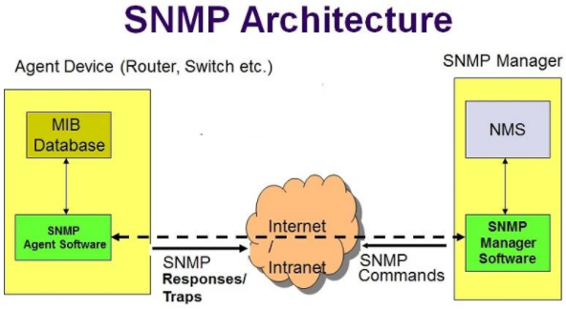

Slide 55
Tool:
Opmanager [ commercial tool ]
Snmp-check enumeration tool
https://tools.kali.org/information-gathering/snmp-check
https://highon.coffee/blog/penetration-testing-tools-cheat-sheet/#snmp-enumeration-tools
Nmap –p 161 –script=snmp-info <target-ip>

Slide 56
SMTP & DNS[ seen at RECON phase ]
Simple Mail Transfer Protocol
VRFY verify the user is valid or not
EXPN Verify the user and enumerate the username list
RCPT TO checking the receiver address
Reference: http://pentestmonkey.net/tools/user-enumeration/smtp-user-enum

Slide 57
Tools:
Smtp-user-enum
Checking the username is valid or not +
nmap --script smtp-enum-users.nse <target>

Slide 58
LDAP
The Lightweight Directory Access Protocol is a protocol used to access directory listings within Active Directory or from other Directory Services.
A directory is usually compiled in a hierarchical and logical format
Command:
Ad-ldap-enum
nmap -p 389 --script ldap-search <target>

Slide 59
Countermeasures
Use SNMP v3
Use different username for mail id address
Use SSL for LDAP communication
Disable the port 137,161
Filter unknown recipients address to validate the address

Slide 60
Sniffing

Slide 61
Sniffing
Process of monitoring and capturing all the packets passing through a given network using sniffing tools
Sensitive information obtained from sniffing:
FTP Password
Telnet password
DNS traffic
Web traffic
Router configuration
Packets passing through network

Slide 62
How sniff’s works
Promiscuous mode
- capturing all packets are passing through interface
https://tots.1o24.org/how-to-check-if-promiscuous-mode-is-enabled-on-network-interface-in-linux/

Slide 63
Sniffing Attack Method
MAC
ARP
DHCP
DNS

Slide 64
MAC sniffing
Change the mac address and sniffing the packets from the target address.
Advantages:
Update the mac address instead of original one
Tools:
Macchanger

Slide 65
ARP sniffing
Sending multiple ARP requests to target network
Advantages:
Take a control of network and sniffing the network
Tools:
Arping

Slide 66
DHCP sniffing

Slide 67
DHCP Attack:
DHCP Starvation attack
Sending multiple DHCP request with spoofed mac address to DHCP server. At last, legitimate user unable to get address
Rogue DHCP attack
Instead of original DHCP server, rogue (attacker dhcp server) will send offer and request to dhcp client. So, entire network traffic will send through rogue server.

Slide 68
DNS sniffing
Altering or modified the IP address of dns config
Attack :
Intranet local dns spoof
Change the value in local internet dns server
Internet DNS spoof
Providing the incorrect ip address after modified the address of dns server ip address ( attacker ip address provided)
Proxy DNS
Send via fake website into request one
DNS cache
Altered the address of dns cache

Slide 69
Sniffing Tools
Ettercap
Wireshark or tcpdump
https://hackertarget.com/wireshark-tutorial-and-cheat-sheet/

Slide 70
LIVE DEMO

Slide 71
Sniffing Attack Detection techniques
IDS
Promiscuous mode
Detect the promiscuous mode
Ping to repect ip address [ sending fake packet with it’s ip address and fake mac address. If reply from machine means it’s running promiscuous mode]

Slide 72
Counter measures

Slide 73
Denial of service

Slide 74
Denial of service
Attempt to prevent legitimate users from accessing the service.
DoS attack,
the attacker usually sends excessive messages asking the network or server to authenticate requests that have invalid return addresses.
Request
Server

Slide 76
Techniques
Volumetric Attacks
Bandwidth attack
Fragmentation Attacks
Overwhelming re-fragmentation
Tcp state exhaustion Attack [ Protocol Attack ]
Service request attack
SYN attack [ Never complete the TCP handshake with fake address { didn’t send Ack of syn/ack }]
SYN Flood attack [ Flooding the SYN packets. Holding 70 sec for ACK of syn/ack]
Application Layer Attacks
Sending multiple request to application server
MISC
Peer 2 peer attack [ exploit the server and send request to target address ]
Permanent DOS [ updating hardware firmware ]
Distributed Reflection DOS [ by using intermediate system to attack the target address ]

Slide 77
Botnet
Running automated tasks over the internet and performing simple repetitive task such as web spider and web searching etc..

Slide 78
DDOS TOOLS:
Linux
Xerxes.c [ Most Powerful ddos tool]
Windows
LOIC
HOIC

Slide 79
Countermeasures
IDS & IPS
Antivirus & Anti spyware
Reverse DNS to look up the source address
Ingress & egress should filter the address
Incepted the header of ip packet and implementation of block the unwanted traffic

Slide 80
Resources:
https://www.cloudflare.com/learning/ddos/what-is-a-ddos-attack/
https://pdfs.semanticscholar.org/a276/00d2c0619bcdc7e1d6e13103ff8aaa390144.pdf
https://sites.google.com/a/pccare.vn/it/security-pages/dos-attacks-and-countermeasures

Slide 82
Social Engineering

Slide 83
Social Engineering
Art of Convincing people to reveal the confidential information
Cons:
Economical loss
Loss of privacy
Damage of goodwill

Slide 84
Why it’s effective
“There is no fix for social Engineering attack”
Reason:
Difficult to detect
No specific software or hardware
No ensure to ensure complete security

Slide 85
Phases in Social Engineering
Research on Target
Select a victim
Develop relationship
Exploit the relationship [ collect sensitive information ]

Slide 86
Types of social Engineering
Human based
Impersonation [ gathering sensitive info who acts like legitimate person ]
Help desk
Third party Authorization [ act like verification from company to victim employee]
Tech support
Repairman
Eavesdropping & shoulder surfing
Dumpster diving [ Gathering information from trash like billing details]
Piggybacking
Tail gating
Computer based
Phishing
Mobile based
sms
Malicious apps [ fake security apps ]

Slide 87
Phishing
Acts like a legitimate page but it is spear our sensitive details to attackers
There are various ways to attacks
Mail
Link shared via sharing medium

Slide 88
Counter measures
Training & Awareness
Operation guidelines [ sensitive info handled by authorized person ]
Access privileges
Classification of privileges [ top secret , not important]
Use antivirus software & detect phishing attacks

Slide 89
Cryptography

Slide 90
Objectives
Encrypt and decrypt the data and transmission on unsecured network.
Objectives:
Confidentiality
Authentication
Integrity
Non-repudiation

Slide 91
Types of encryption
Symmetric key encryption
Same pair of key used in encrypt and decrypt
Asymmetric key encryption
Different pair of key used in encrypt and decrypt

Slide 92
Eagle view of encryption Algorithm

Slide 93
Based on type of input data
Block cipher
DES Data encryption standard
AES Advanced encryption standard
Stream cipher
RC4, RC5, Rc6 algorithm [ R means Rivest ]

Slide 94
Based on type of input key
Public Key
Open to share everyone
Private Key
Don’t be share to anyone

Slide 95
Digital signature
Integrity of the data and identity of signature can be verified
Verification can be done by Digital signature Algorithm

Slide 96
RSA [Rivest shamir adleman]
Current internet encryption technique.
Using two different prime number

Slide 97
Hashing
By using Hash function to create a unique fixed size of bit string representation
MD5
Due to conjunction, secure hash algorithm has created.
SHA1
SHA2
SHA3

Slide 98
SSH
Secure shell
Data Transmission over unsecure network
Provided host to host and user authentication communication

Slide 99
Tools:
Online md5 calculator
Search more tool available in online

Slide 100
Public Key Instructure
Set of hardware,software,people policies and procedures required to create, manage,distribute,use,store and revoke digital certificates.
Components:
Certificate management system
Digital certificates
Validation authority
Certificate authority
End user
Registration Authority

Slide 101
PKI Working Model

Slide 102
Certificate Authority
Comodo
Symantec
Entrust
Thawte

Slide 103
Signed vs self certificate

Slide 104
Email Encryption

Slide 105
PGP

Slide 106
SSL

Slide 107
TLS

Slide 108
Disk Encryption

Slide 109
Tools:
Symentec disk encryption
Full disk encryption

Slide 110
Cryptography Toolkit
OpenSSL
Keyczar

Slide 111
Cryptography attacks
Cipher text only attacks
Finding the plain text from set of cipher texts
Known Plaintext Attack
Chosen Plaintext Attack
Dictionary Attack
Brute Force Attack
Man in Middle Attack

Slide 112
Cryptanalysis tools
https://blackarch.org/crypto.html

Slide 113
Web Hacking

Slide 114
Agenda
Web hacking Intro
How web works
Web threats
Web hacking methodologies
Web hacking tools
countermeasures

Slide 115
Web Hacking Intro
Web or web apps are accessible via internet.
Web threats are able to compromise the web apps, system and networks

Slide 116
How web works

Slide 117
Web threats
Web Threats. Web-based threats – or online threats – are malware programs that can target you when you're using the Internet.

Slide 118
Command Injection
execution of arbitrary commands on the host operating system via a vulnerable application
Attacking vector:
Where the input directly interaction with web server host.

Slide 119
SQL Injection

Slide 120
File Inclusion
trick the web application into exposing or running files on the web server
An LFI attack may lead to information disclosure, remote code execution
Attack vector:
Parameter which used to upload/inject a file from user

Slide 121
Malicious file Upload
Similar to file inclusion
Able to create a backdoor for host machine of web app and will do more

Slide 122
XSS

Slide 123
CSRF

Slide 124
Session Hijacking
Cookie is enough to do all malpractice activities

Slide 125
Web Hacking tools
Burp suite
Open source tools
Owasp-zap
Sqlimap
Knoxss

Slide 126
Counter measures

